Slide 1
Living History
A Mobile App to explore preserved historic buildings and locations in the city of Zurich

Slide 2
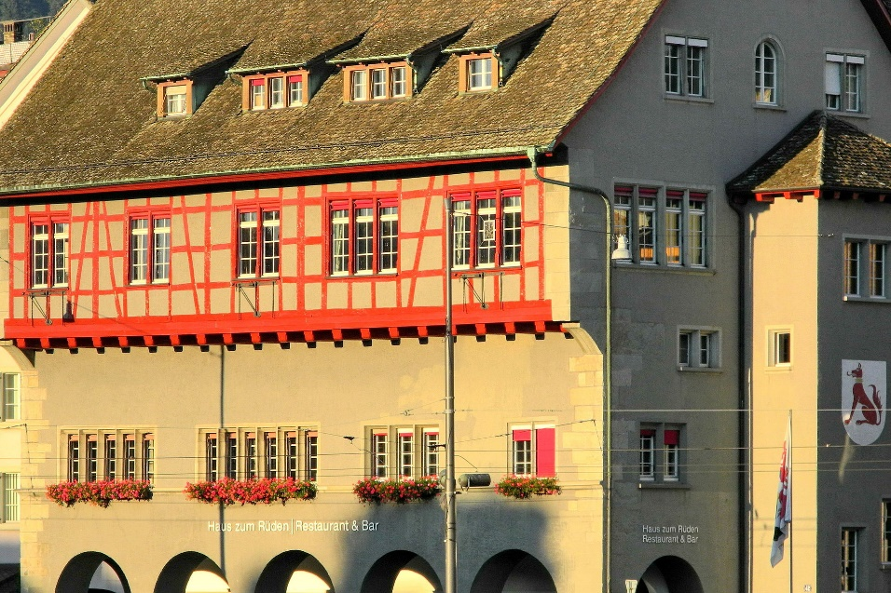
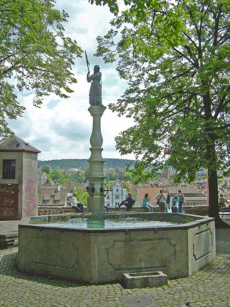
Theme
Preserved Buildings, Monuments, Fountains, Viewpoints and other Objects in Zurich
User-Group: Travellers with an interest into historic preservation that want to explore the city by foot
Swiss Tourists
Foreign Tourists

Slide 3
Layers
Routing-Service Fussweg / Routing-Service Footway
Denkmalschutzobjekte / Historic and preserved objects
Gartendenkmalpflegeinventar / Inventory of preserved gardens
Brunnen / fountains and wells
Aussichtspunkte / view points
Basemap: standard, OSM or other service

Slide 4
Concept
Request | Response
Where am I? | Position
Where is the closest preserved object? | Single Object
Which objects are nearby (in a search radius)? | List / Map
How do I get there? | Path
What’s important about this object? | Information

Slide 5
Functionality
Mapview
Location
Layer Filtering
Search-function (closest / radius)
Search-function (by name or subcategory, autofill)
Routing
Infowindow
Listview (show search results in a list)
Language Selection

Slide 6
Use Flow
MapView
Search Window
Information
Search Results
Routing
Zoomed on user’s location

